Slide 1
Calculating Displacement

Slide 2
By the end of the lesson, you should be able to:
Calculate displacements.
State Pythagoras' Theorem.
Calculate distances using Pythagoras' Theorem.

Slide 3
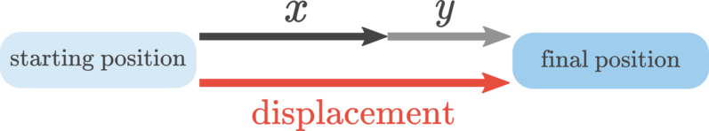
Calculating Displacement
If an object travels a distance x in a certain direction and then travels a distance y in the same direction, we use the following equation to calculate its displacement (s):
s=x+y

Slide 4
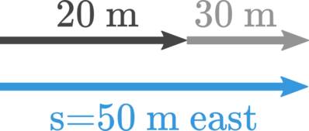
Consider a surfer. He paddles east away from the beach, out into the sea. After reaching 20 m, he stops to rest. Then he starts paddling again for a further 30 m in the same direction.
The surfer's displacement can be found by adding together those two distances, like this:
s = 20 m+30 m=50 m east

Slide 5
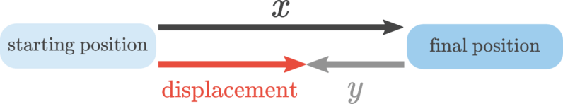
If an object travels a distance x in a certain direction and then travels distance y in the opposite direction, we use the following formula to calculate displacement:
s=x−y

Slide 6
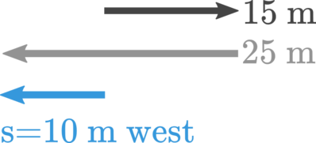
For this example, let's have a look at another surfer. Suppose he paddles 15 m to the east, then catches a wave that carries him 25 m to the west. To find his displacement, we need to subtract these two distances because they are in opposite directions.
s=25 m−15 m=10 m west

Slide 7
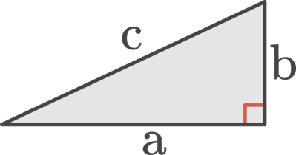
Pythagoras' Theorem is a mathematical expression that relates the three side lengths of a right-angled triangle.
Consider this triangle. It has a right angle shown by the red square.
The side opposite the right angle, c, is the longest side of the triangle. a and b are simply the other two sides.

Slide 8
Pythagoras' Theorem is defined by the following equation:
c²=a²+b²

Slide 9
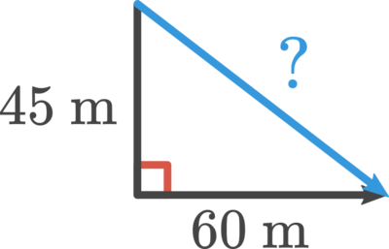
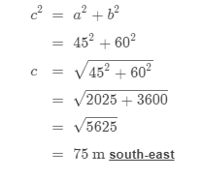
Now let's put some numbers on that triangle and find the perentie's displacement. Say it moved 45 m south, then smelled a tasty BBQ down the road and walked 60 m east toward it.
In the equation for Pythagoras' Theorem, we can say a=45 m and b=60 m.

